Slide 1

Course : COMP6232 / Human - Computer Interaction
Year : 2016
ESTABLISHING REQUIREMENTS
SESSION 08

Slide 2
LEARNING OUTCOMES
LO 3 : Choose the data gathering technique from
user to develop successful interaction design

Slide 3
OUTLINE
^{Introduction}
^{What, How, and Why}
^{What are Requirements}
^{Data Gathering for Requirement}
^{Task Description}
^{Task Analysis}

Slide 4
INTRODUCTION
There is an initial set of requirements or by producing a set of requirements from scratch to start a project.
Whatever the initial situation and whatever the aim of the project, the user’s needs , requirements, aspirations, and expectations have to be discussed, refined, and clarified.
This requires an understanding of, the users and the capabilities, their current and goals, the conditions under which the product will be used, and constraints on the product’s performance.

Slide 5
WHAT
WHAT, HOW, AND WHY ?
What are we trying to achieve in the Requirement Activity ?
There are two aims :
  To understand as much as possible about the users, their activities, and the context of that activity
  To produce a set of stable requirements that form a sound basis to start designing.

Slide 6
HOW
WHAT, HOW, AND WHY ?
How Can We Achieve This ?
Step by step Requirement Activity :
  At the beginning : a lot to find out and to clarify
  In the middle : concerned with data gathering, analysis, interpretation, and presentation.
  At the end : there is a set of stable requirements that can be the basis of the design activity.

Slide 7
WHY
WHAT, HOW, AND WHY ?
Why ‘Establish’ Requirements ?
The activity of understanding what a product should do has been given various labels, for example requirement gathering, requirement capture, requirement elicitation, requirement analysis and requirements engineering.
We choose the term establish requirements to represent the fact that requirements have been established from a sound understanding of the users needs and that they can be justified by and related back to the data collected.

Slide 8
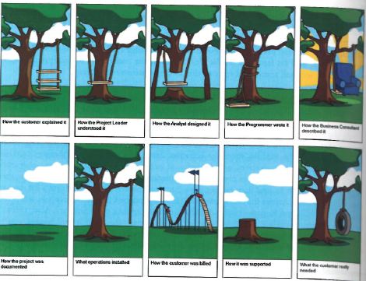
WHY
WHAT, HOW, AND WHY ?
Why ‘Establish’ Requirements ?
This fig.08.01. illustrates what can go wrong if requirements are not clearly articulated
Figure 08.01 Cartoon related with requirements

Slide 9
WHAT ARE REQUIREMENTS ?
Requirement :
  Is a statement about an intended product that specifies what is should do or how it should perform.
The example requirement shown in figure 08.02

Slide 10
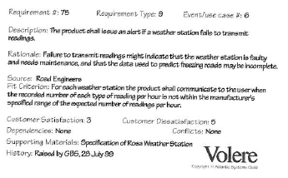
WHAT ARE REQUIREMENTS ?
An example requirement using the Volere Shell
Figure 08.02 Cartoon related with requirements

Slide 11
WHAT ARE REQUIREMENTS ?
Different kinds of Requirements :
Functional Requirements :
  capture what the product should do.
Data Requirements :
capture the type, volatility, size/amount, persistence, accuracy, and value of the required data.
Environmental Requirements :
refer to the circumstances in which the interactive product will operate.

Slide 12
WHAT ARE REQUIREMENTS ?
Different kinds of Requirements :
Four aspects of the environment must be consider when establishing requirements :
a. physical environment such as how much lighting, noise, movement an dust is expected in the operational environment.
b. social environment regarding the social aspects of interaction design

Slide 13
WHAT ARE REQUIREMENTS ?
c. organizational environment e.g. how good is user support likely to be, how easily can it be obtained and are there facilities or resources for training ?
d. technical environment e.g. what technologies will the product run on or need to be compatible with, and what technological limitations might be relevant ?

Slide 14
WHAT ARE REQUIREMENTS ?
  User Characteristics : capture the key attributes of the intended user group.
  Persona : rich descriptions of typical users of the product under development that the designers can focus on and design the product for. A persona will include the description of the user’s skill, attitudes, tasks, and environments.
  Usability Goals and user experience goals : These are another requirements and should be captured together with appropriate measures.

Slide 15
DATA GATHERING FOR
REQUIREMENTS
The overall purpose of data gathering in the
requirements activity is :
  To collect sufficient, relevant, and appropriate data so that a set of stable requirements can be produced.
There are some forms of data gathering :
Interviews
Questionnaires
Direct and Indirect Observation
Studying documentation
Researching similar products

Slide 16
DATA GATHERING FOR
REQUIREMENTS
Data Gathering Guidelines for Requirements :
Focus on identifying the stakeholders’ needs
Involve all the stakeholder groups
Involving more than one representative from each stakeholder group especially if the group is large.
Support the data gathering sessions with suitable props, such as task descriptions and prototypes if available.

Slide 17
TASK DESCRIPTION
Task Descriptions are used throughout development, from early requirements activities through prototyping , evaluation, and testing.
There are three of common description types :
  Scenarios
  Use cases
  Essential user cases ( task cases)

Slide 18
Scenario
TASK DESCRIPTION
A scenario is an ‘informal narrative description’ (Carroll,2000).
It describes human activities or tasks in a story that allows exploration and discussion of contexts, needs, and requirements.
The scenario that we refer only in their role of helping to establish requirements.

Slide 19
Scenario
TASK DESCRIPTION
Example of scenario that might generated by potential users of a movie rental club :
Say I want to find a movie directed by Martin Scorsese. I don’t remember the title but I know it came out in the cinemas around 2006 or 2007.I go to the club website and choose the director option. A huge list of directors is displayed- I had no idea there were so many directors with surnames beginning with S! After scrolling through the list find Martin Scorsese and choose to see further detail about him. Another long list of movies eventually leads me to the movie I was looking for – The Departed. As an existing club member, I need to enter my username and password to be able to rent the movie. Once my password has been confirmed, I am given a choice of rental period and payment method I have my preferences already registered in the system, so I just choose the defaults and download my movie.

Slide 20
Scenario
TASK DESCRIPTION
In the limited scenario of existing system use, there are some things of note : the long lists of names and movies that the user has to scroll through, the lack of detailed search possibilities, the importance of choice around rental period, and the usefulness of having default settings chosen by regular users. These are all indicators of potential design choices for the new system.
Capturing scenarios of existing behavior and goals helps in determining new scenarios and hence in gathering data useful for establishing the new requirements.

Slide 21
Use Case
TASK DESCRIPTION
Use case is associated with an actor and it is the actor’s goal in using the system that the use case want to capture.
For example : A use case for retrieving the visa requirement using the travel organizer, with the normal course being that information about the visa requirement is available, might be :
  The system displays options for investigating visa and vaccination requirements
  The user chooses the option to find out about visa

Slide 22
Use Case
TASK DESCRIPTION
  The system prompts user for the name of the destination country.
  The user enters the country’s name.
  The system checks that the country is valid.
  The system prompts the user for her nationality.
  The user enters her nationality.
  The system checks the visa requirements of the entered country for a passport holder of her nationality.
  The system displays the visa requirement.
  The system displays the option to print out the visa requirements.
  The user chooses to print the requirements.

Slide 23
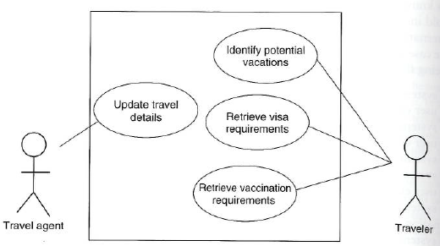
Use Case
TASK DESCRIPTION
Figure 08.03 shows the use case diagram for the travel organizer showing four use cases and two actors
Figure 08.03 Use case diagram for the travel organizer

Slide 24
Use Case
TASK DESCRIPTION
To develop a use case, first identify the actors, i.e. the people or other system, that will be interacting with the system under development.
Then examine these actors
Identify their goal or goals in using the system.
Each of these will be a use case.

Slide 25
Essential Use Case
TASK DESCRIPTION
Developed by Constantine and Lockwood (1999) to combat what they see as the limitation of both scenarios and use cases as described above.
Represent abstractions from scenarios, i.e. they represent a more general case than a scenario embodies and try to avoid the assumptions of a traditional use case.
An essential use case is a structured narrative consisting of three parts :
  A name that expresses the overall user intention

Slide 26
Essential Use Case
TASK DESCRIPTION
  A stepped description of user actions
  A stepped description of system responsibility
This division between user and system responsibilities can be very helpful during conceptual design when considering task allocation and system scope.
An example essential use case based on the visa requirement example given before.(see table 08.01)

Slide 27
Essential Use Case
TASK DESCRIPTION
Table 08.01 An essential use case for retrieving visa requirements in the travel organizer
USER INTENTION | SYSTEM RESPONSIBILITY
Find visa requirements | Request destination and nationality
Supply required information | Obtain appropriate visa information
Obtain a personal copy of visa information | Offer information in different formats
Choose suitable format | Provide information in chosen format

Slide 28
Essential Use Case
TASK DESCRIPTION
Instead of actors, essential use cases are associated with user roles.
An actor could be another system.
User role is a role that a number of different people may play when using the system.
As with use cases, producing essential use case begins with identifying user roles.

Slide 29
TASK ANALYSIS
Used mainly to investigate an existing situation, not to envision new products.
Used to analyze the underlying rationale and purpose of what people are doing: what are they trying to achieve, why are they trying to achieve it, and how are they going about it.
The information gleaned from task analysis establishes a foundation of existing practices on which to build new requirements or design new tasks.

Slide 30
Hierarchical Task Analysis
TASK ANALYSIS
HTA (Hierarchical Task Analysis) was originally designed to identify training needs ( Annett and Duncan 1967).
It involves breaking a task down into subtask and then into sub-sub tasks and so on.
Then grouped together as plans that specify how the tasks might be performed in an actual situation.

Slide 31
Hierarchical Task Analysis
TASK ANALYSIS
The starting point is a user goal. Then examined and the main tasks associated with achieving that goal are identified.
Where appropriate, these tasks are subdivided into subtasks and then subtasks can be divided further-down to low level steps of the interaction which may be represented in a screen sketch.

Slide 32
Hierarchical Task Analysis
TASK ANALYSIS
The example of HTA for buying a DVD. The subtasks for buying a DVD and one plan showing two alternative paths through those subtasks.
0. In order to buy a DVD
1. locate DVD
2. add DVD to shopping basket
3. enter payment details
4. complete address
5. confirm order
Plan 0 : if regular user do 1-2-5. If new user do 1-2-3-4-5

Slide 33
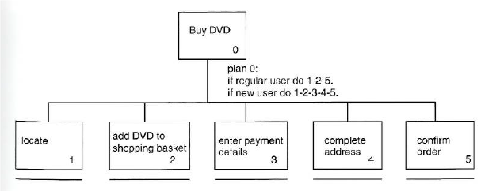
Hierarchical Task Analysis
TASK ANALYSIS
The alternative expression of an HTA is a graphical box and line notation. ( Fig 08.05).
Figure 08.05 A graphical representation of the task analysis for buying a DVD

Slide 34
Hierarchical Task Analysis
TASK ANALYSIS
There are two main problems with using HTA on real problems :
  Real task are very complex The notation soon becomes unwieldy.
  Task analysis is limited in the kinds of task it can model.

Slide 35
Hierarchical Task Analysis
TASK ANALYSIS
On other hand, benefits of task analysis include ( Hornsby,2010) :
  Let you objectively alternative designs based on user’s planned tasks and subtasks.
  Provides a good understanding of the interaction at whichever level of abstraction is appropriate.
  Supports design reuse- again at different level of abstraction.

Slide 36
REFERENCES
http://www.cdc.gov/healthyyouth/evaluation/pdf/brief16.pdf
https://www.interaction-design.org/encyclopedia/ethnography.html
http://www.id-book.com/firstedition/interactive_perlman.htm
http://usabilitygeek.com/requirements-gathering-user-experience-pt1/
http://usabilitygeek.com/requirements-gathering-a-step-by-step-approach-for-a-better-user-experience-part-2/

